Slide 1
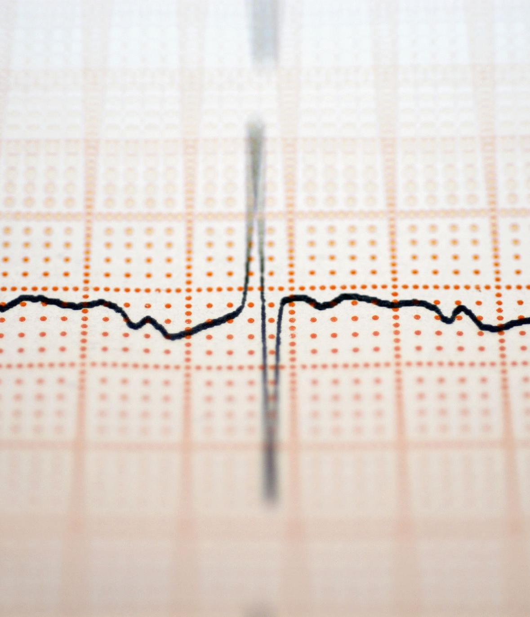
Heart Disease Prediction

Slide 2
Team Members
Our team consists of Three members with a diverse set of skills and backgrounds. We have expertise in machine learning and Data Science.
Dharanidhar Manne
Sravya Kaitha
Chaitra Angadi

Slide 3

Statement of Project Objectives
The project's goal is to create a machine learning model that can be used to analyze health data and forecast the risk of heart disease. Developing a predictive model, examining and preprocessing the dataset, and assessing model accuracy are among the goals. The predictive model, the data exploration report, and the model evaluation metrics are important deliverables. Healthcare practitioners and data scientists are among the stakeholders, and reaching an 87.5% disease prediction accuracy is the success criterion.

Slide 4
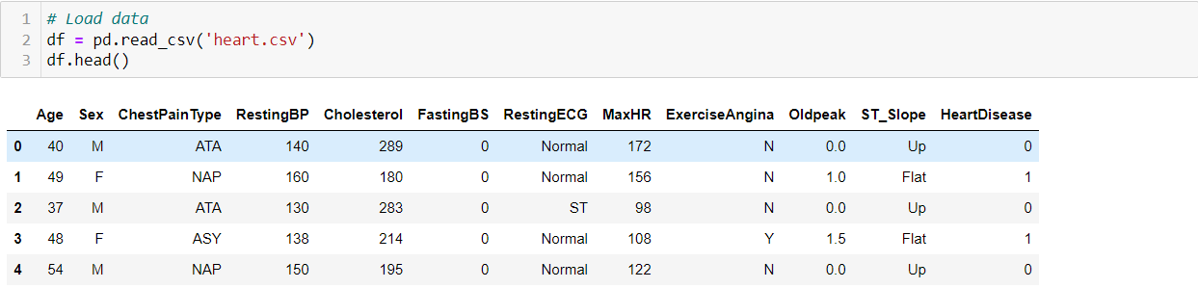
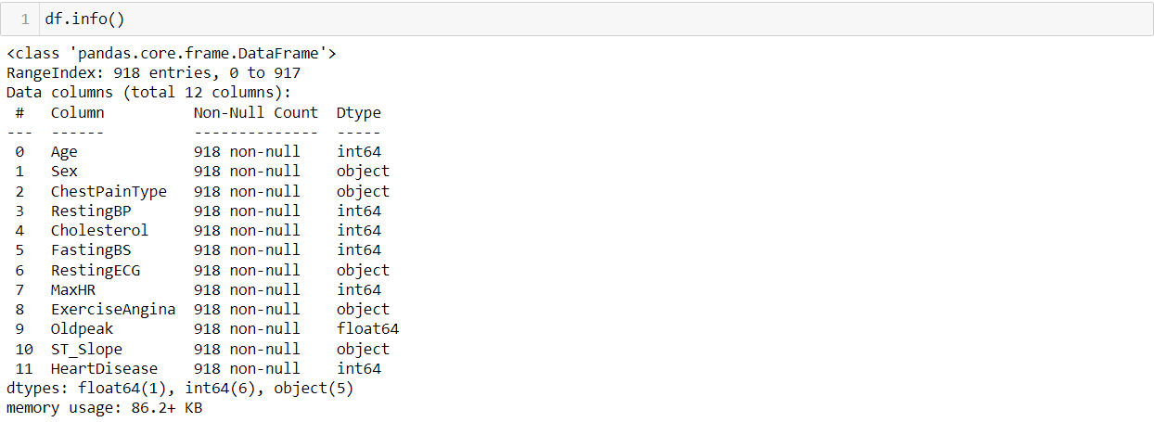
Deliverables
A. Exploratory Data Analysis:

Slide 5
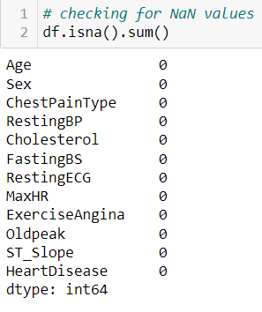
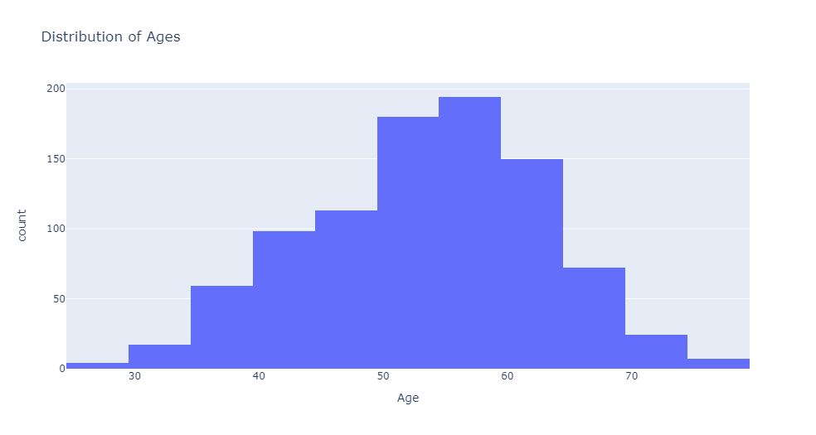

Slide 6
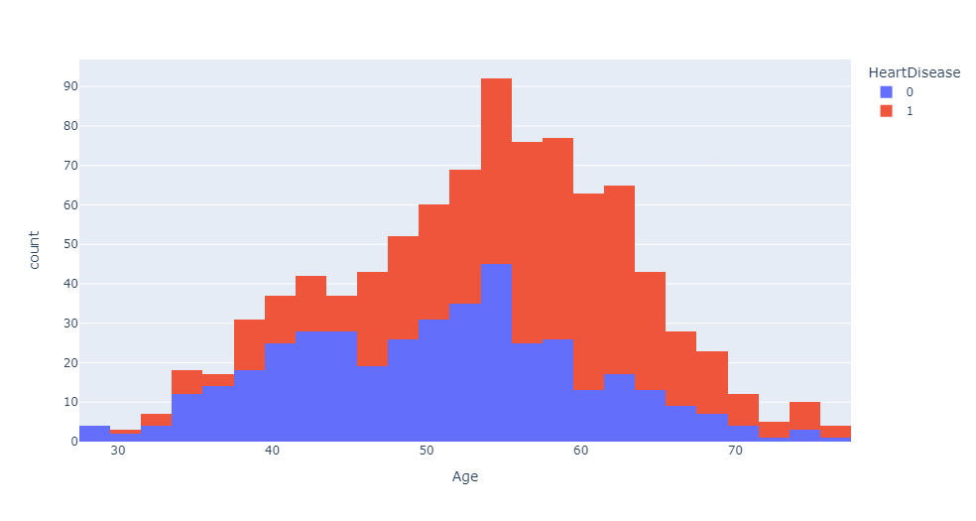
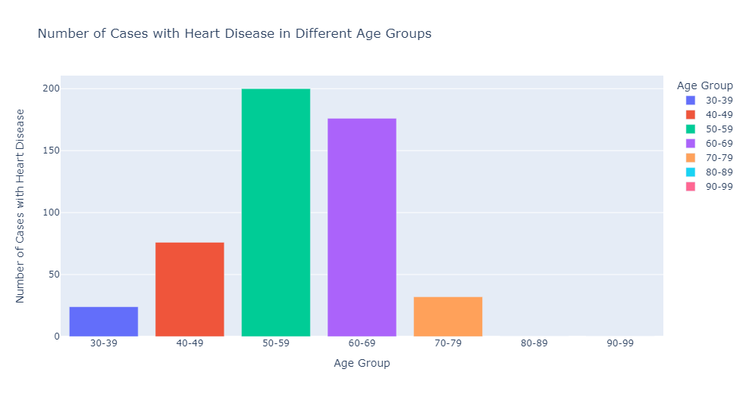

Slide 7
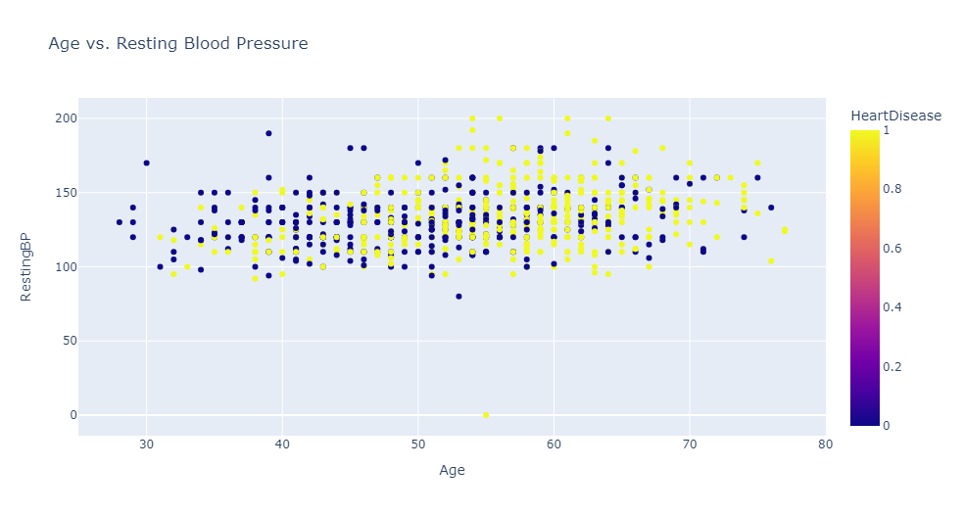
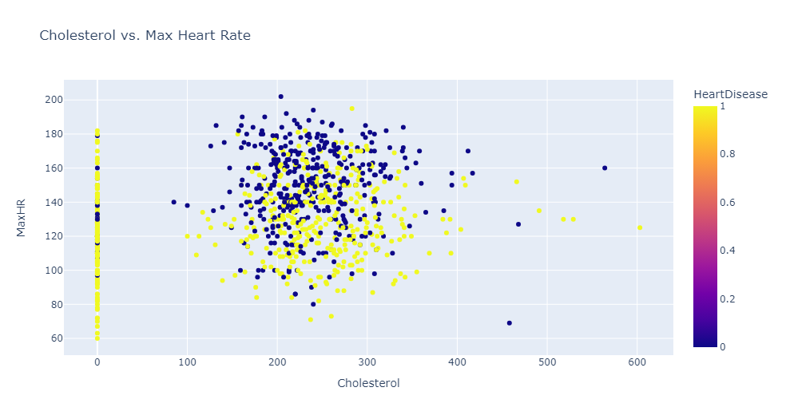

Slide 8
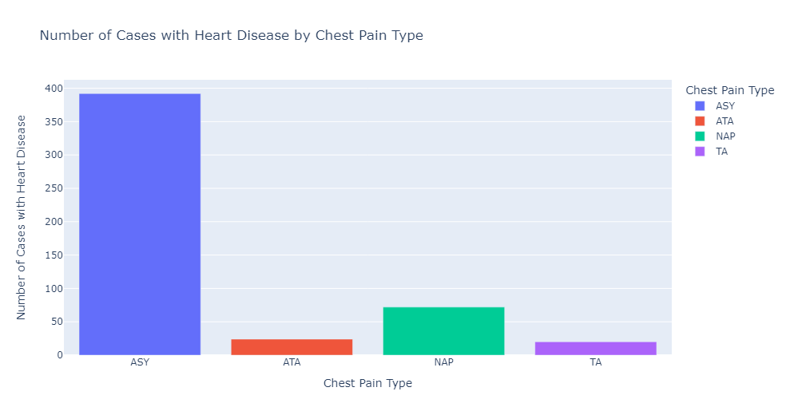
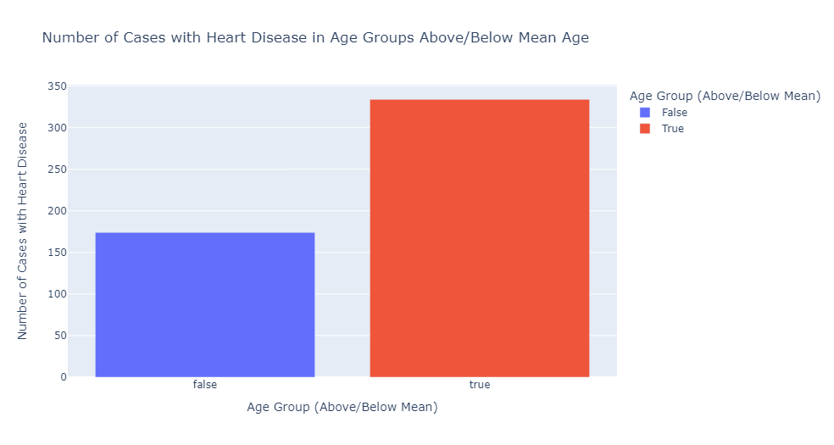

Slide 9
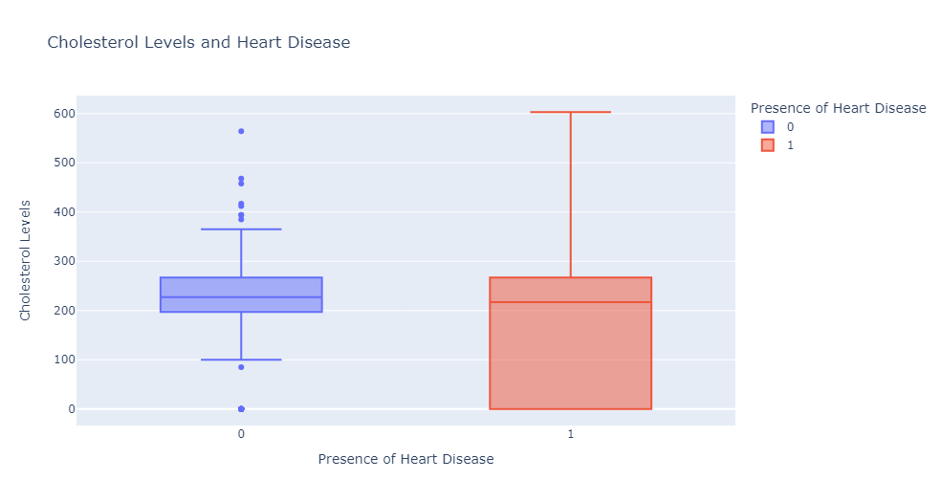
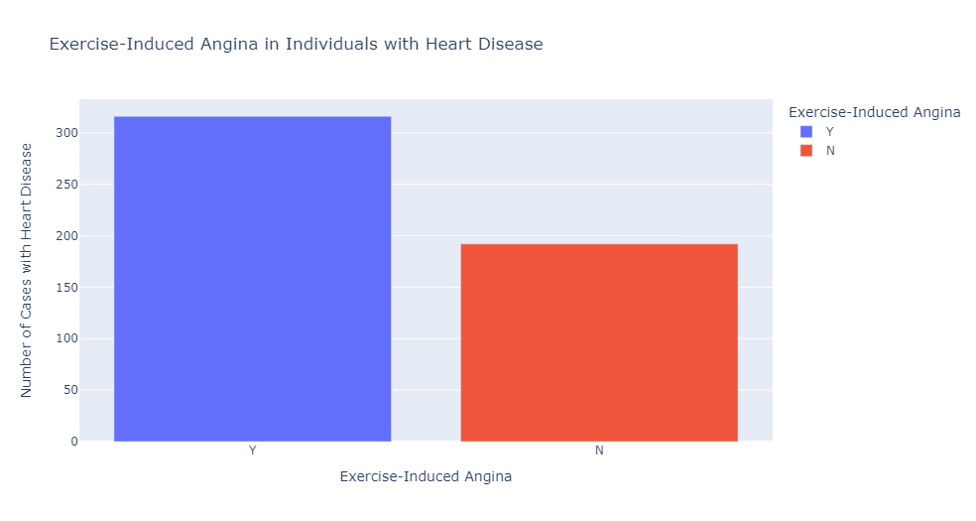

Slide 10
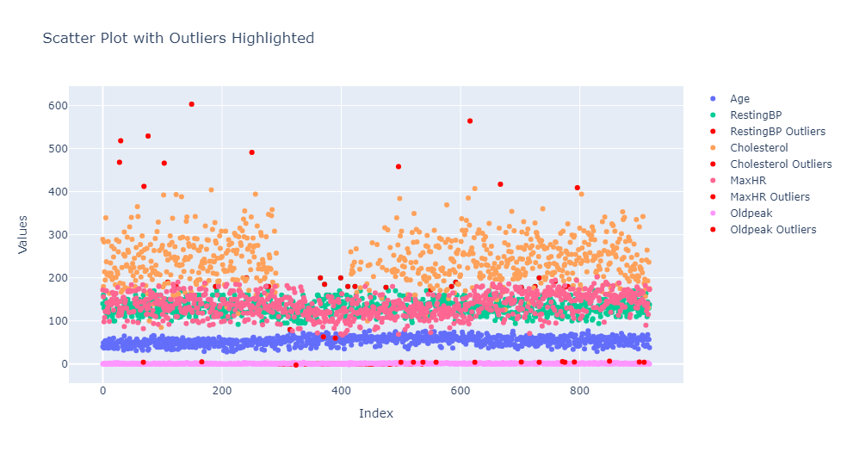
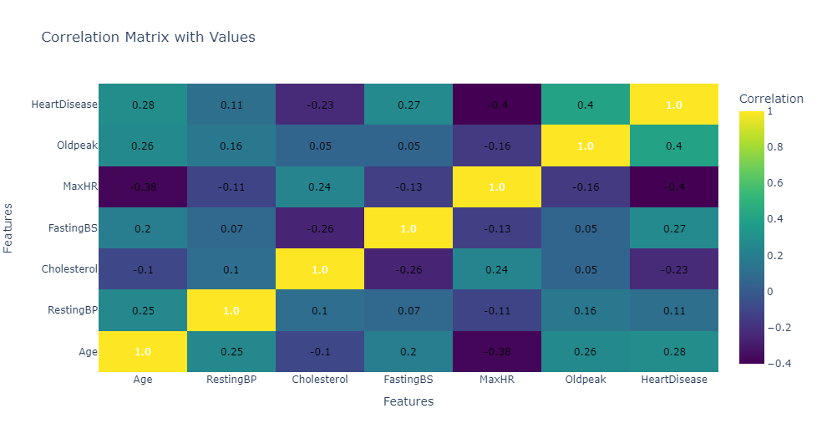

Slide 11
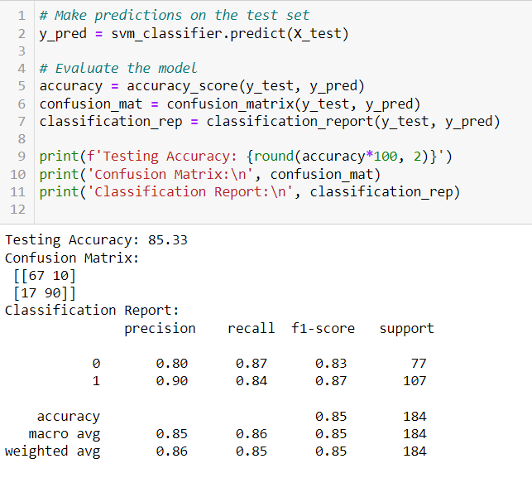
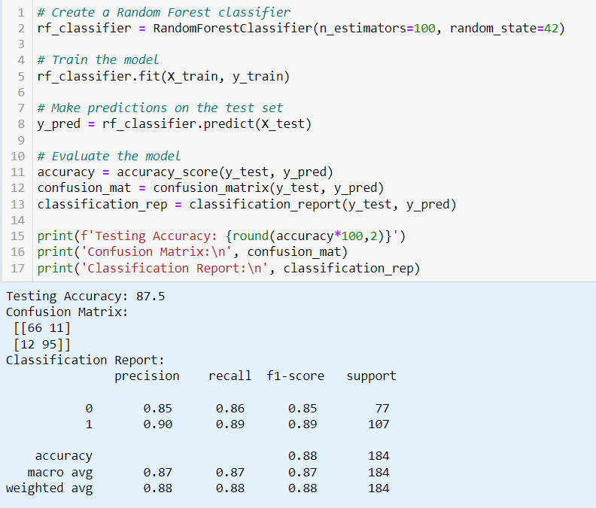

Slide 12
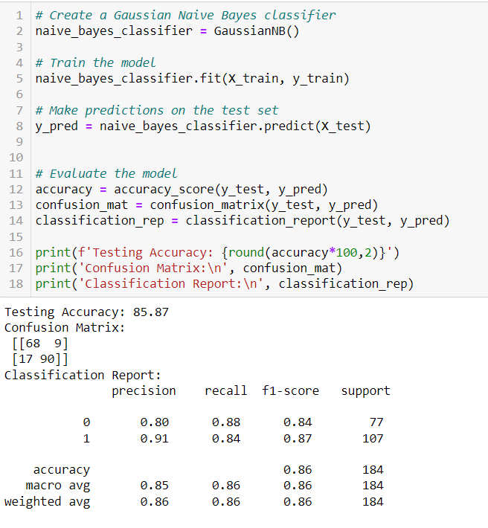
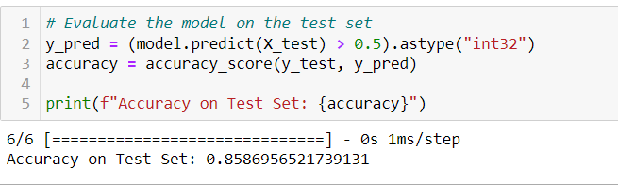

Slide 13
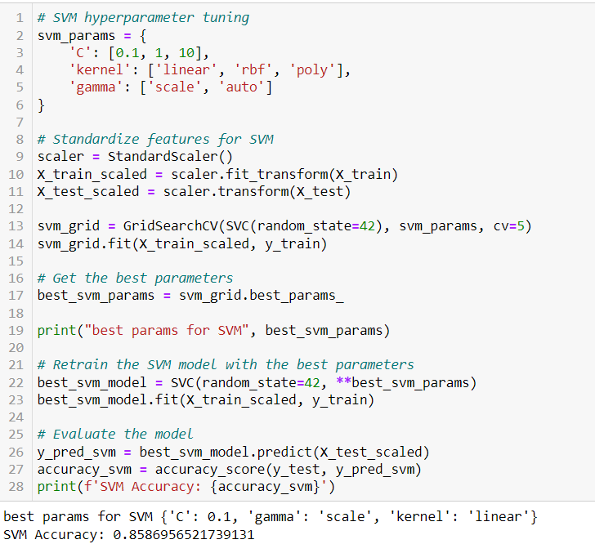
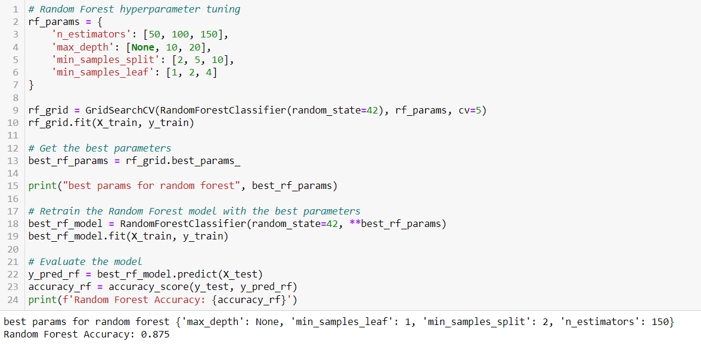
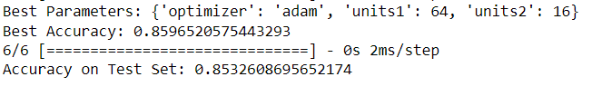

Slide 14
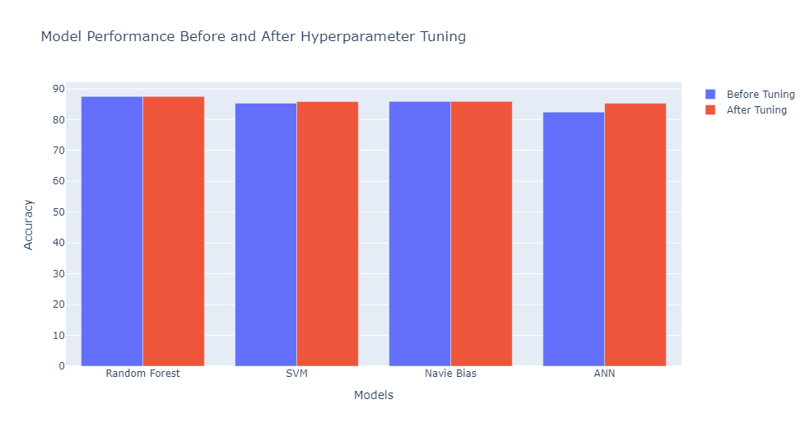

Slide 15
References:
https://towardsdatascience.com/heart-disease-prediction-73468d630cfc
https://www.ncbi.nlm.nih.gov/pmc/articles/PMC10150633/
https://www.ncbi.nlm.nih.gov/pmc/articles/PMC6836338/
Dataset:
https://www.kaggle.com/datasets/fedesoriano/heart-failure-prediction

Slide 16

Thank you

